Slide 1
How to make a Discord bot using Python
3rd March 2022
Charlie Ravlen
Notes:
Section title slide.

Slide 2
What is a Discord bot?
It's a program that can interact with the Discord API and can act as a user
We can program our bots to react to messages, manage our servers and play audio on a voice channel
Examples of this include music bots such as Rythm and Hydra as well as server management bots like Tatsu

Slide 3
How to start?
First of all you'll need the Discord.py API as well as an environment to program and run your bot
We can install discord.py using the following commands in an elevated terminal – make sure you install the version with voice support.
Windows Users: py -3 –m pip install –U discord.py[voice]
Linux Users: python3 –m pip install –U discord.py[voice]
Sourced from https://discordpy.readthedocs.io/en/stable/intro.html

Slide 4
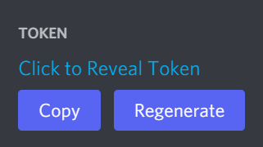
Creating our bot
Head over to https://discord.com/developers/applications and create a new application, give it a name and head over to the bot section for the new app.
Here we can get our token – do not share this token as it is unique to your bot and will allow others to login as your bot.

Slide 5
Creating our bot
Head over to https://discord.com/developers/applications and create a new application, give it a name and head over to the bot section for the new app.
Here we can get our token – do not share this token as it is unique to your bot and will allow others to login as your bot.

Slide 6
Lancaster University PowerPoint Templates
Agenda/Content
Slide topic 1 – with brief description to go here
Slide topic 2 – with brief description to go here
Slide topic 3 – with brief description to go here
Slide topic 4 – with brief description to go here
Slide topic 5 – with brief description to go here

Slide 7
Slide with question?

Slide 8





































Lancaster University PowerPoint Templates: Graphs and Tables
Template slide: text with bullet points and graph
There are three choices of templates with images already inserted.
Please use the template with the relevant image size and positioning.

Slide 9
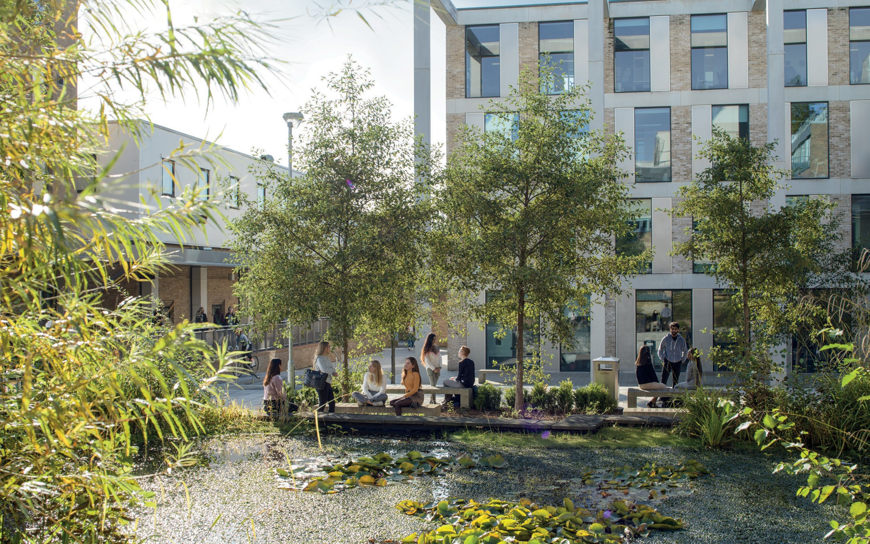
All headers to be Calibri set to 36pt
All main copy is set to Calibri 26pt font size with 30pt line spacing and colour in black.
Colour Lancaster University red: (RGB) R: 181 G: 18 B: 27
Colour grey: (RGB) R: 102 G: 102 B: 102

Slide 10

Lancaster University PowerPoint Templates: Images
Template slide: with bullet points and one image
Use the template with the relevant image size and position.
To insert an image: from the ‘insert’ tab, select ‘picture’, find and select your image, then click ‘insert’.
Images need alt text or marking as decorative for accessibility. Visit Accessibility checklist for PowerPoint.
Resize the image and position to match the example template.

Slide 11

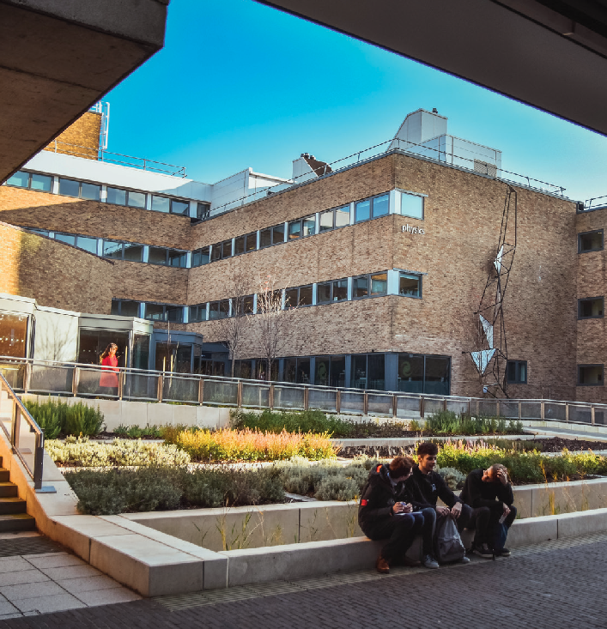
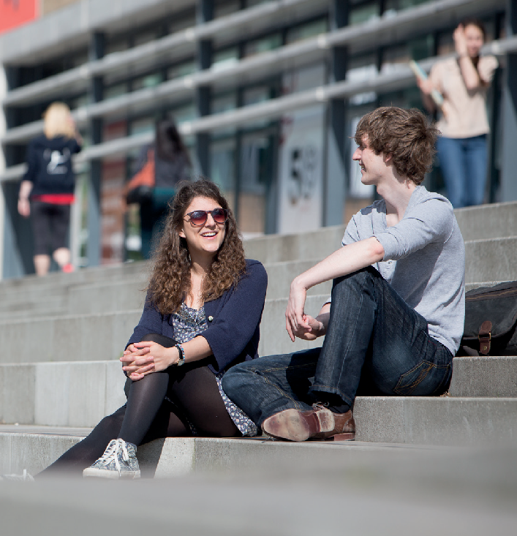
Lancaster University PowerPoint Templates: Images

Slide 12
Short headings
Template slide: with bullet points
Use no more than 5 bullet points
All copy is Calibri
Text size for the main text is 26pt
All text is aligned left
All text is coloured black
Notes:
Variation showing alignment for one line of text as heading

Slide 13
Thank you for attending, any questions?

